Slide 1
Title: Exploring the Unknown: Reinforcement Learning in Maze Navigation
B.tech project by Aman Raj
Mentor: Dr Santosh Kumar Mishra

Slide 2
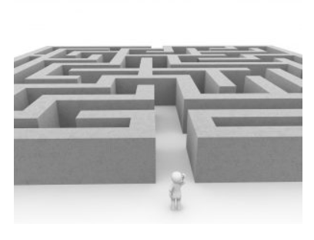
Problem definition
In the context of exploring a new neighborhood without a specific destination, the challenge is to develop a system that can navigate and discover points of interest through random exploration. Reinforcement learning, a form of artificial intelligence, addresses this problem by enabling a system to learn from its environment dynamically, optimizing paths, and making discoveries efficiently.

Slide 3
Proposed Approach: In this engineering project, the objective is to train a computer agent to navigate a maze using a specific machine learning method known as reinforcement learning, with a focus on Q-learning.

Slide 4
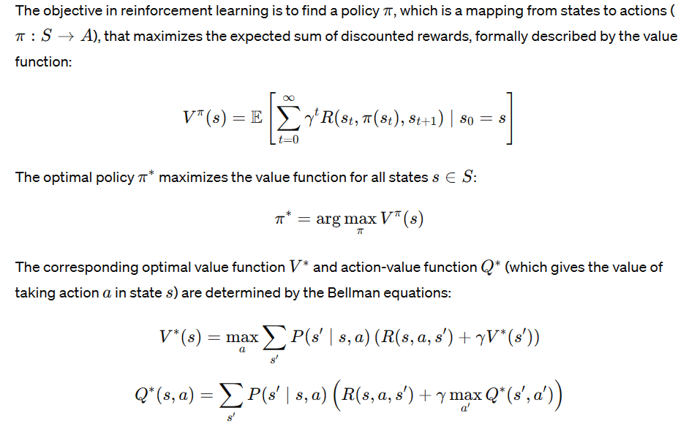
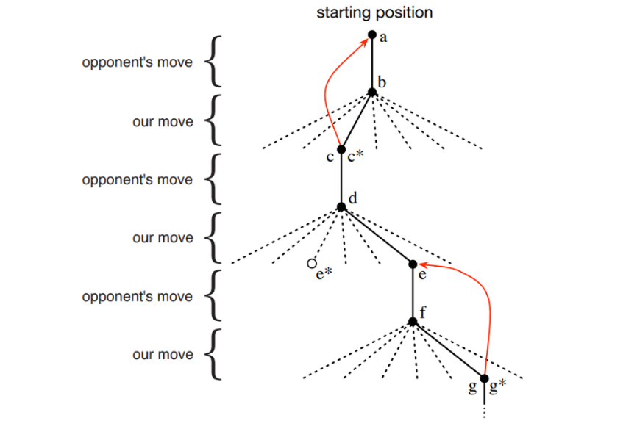

Slide 5
Experimental Procedure
Creating the Maze Environment
Navigating the Maze Untrained
Training the Agent
Evaluating the Agent
Experimenting and Improving
Variations
Create new mazes and test how well the agent performs in more complex mazes with multiple paths and dead ends.

Slide 6
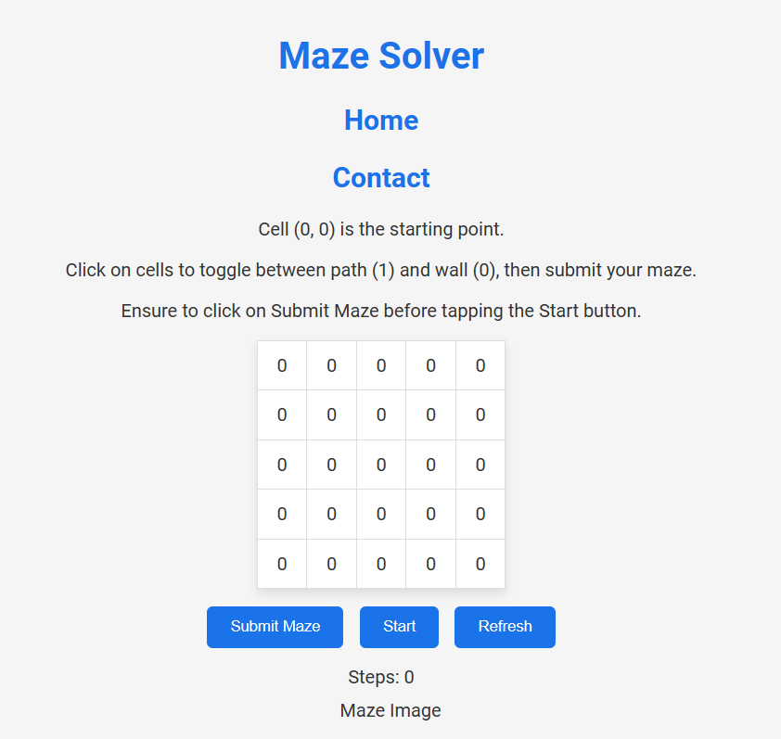


Slide 7
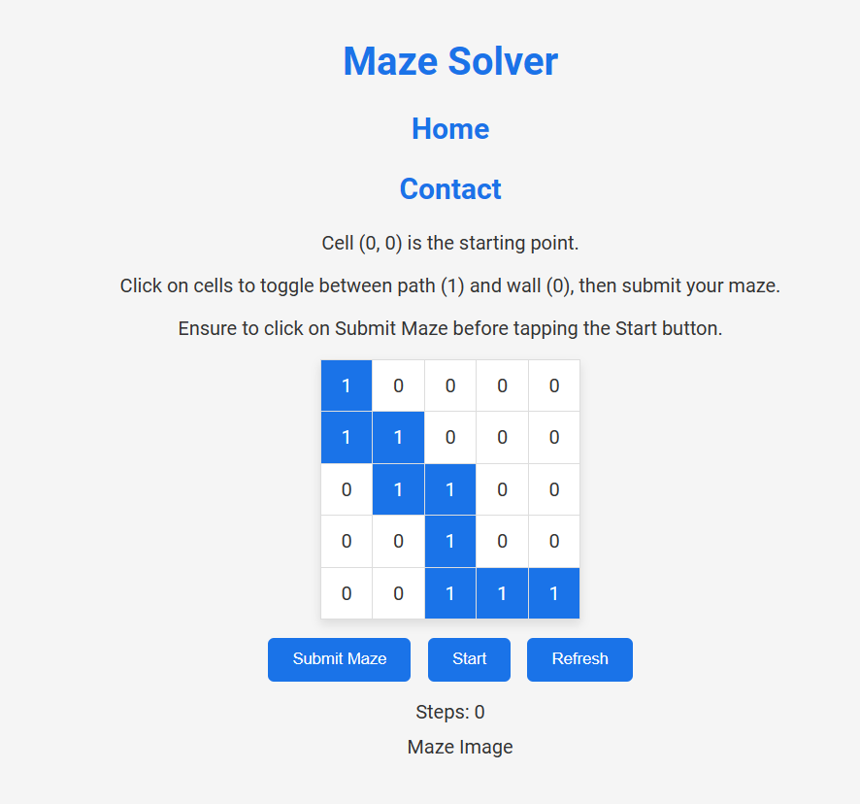

Slide 8
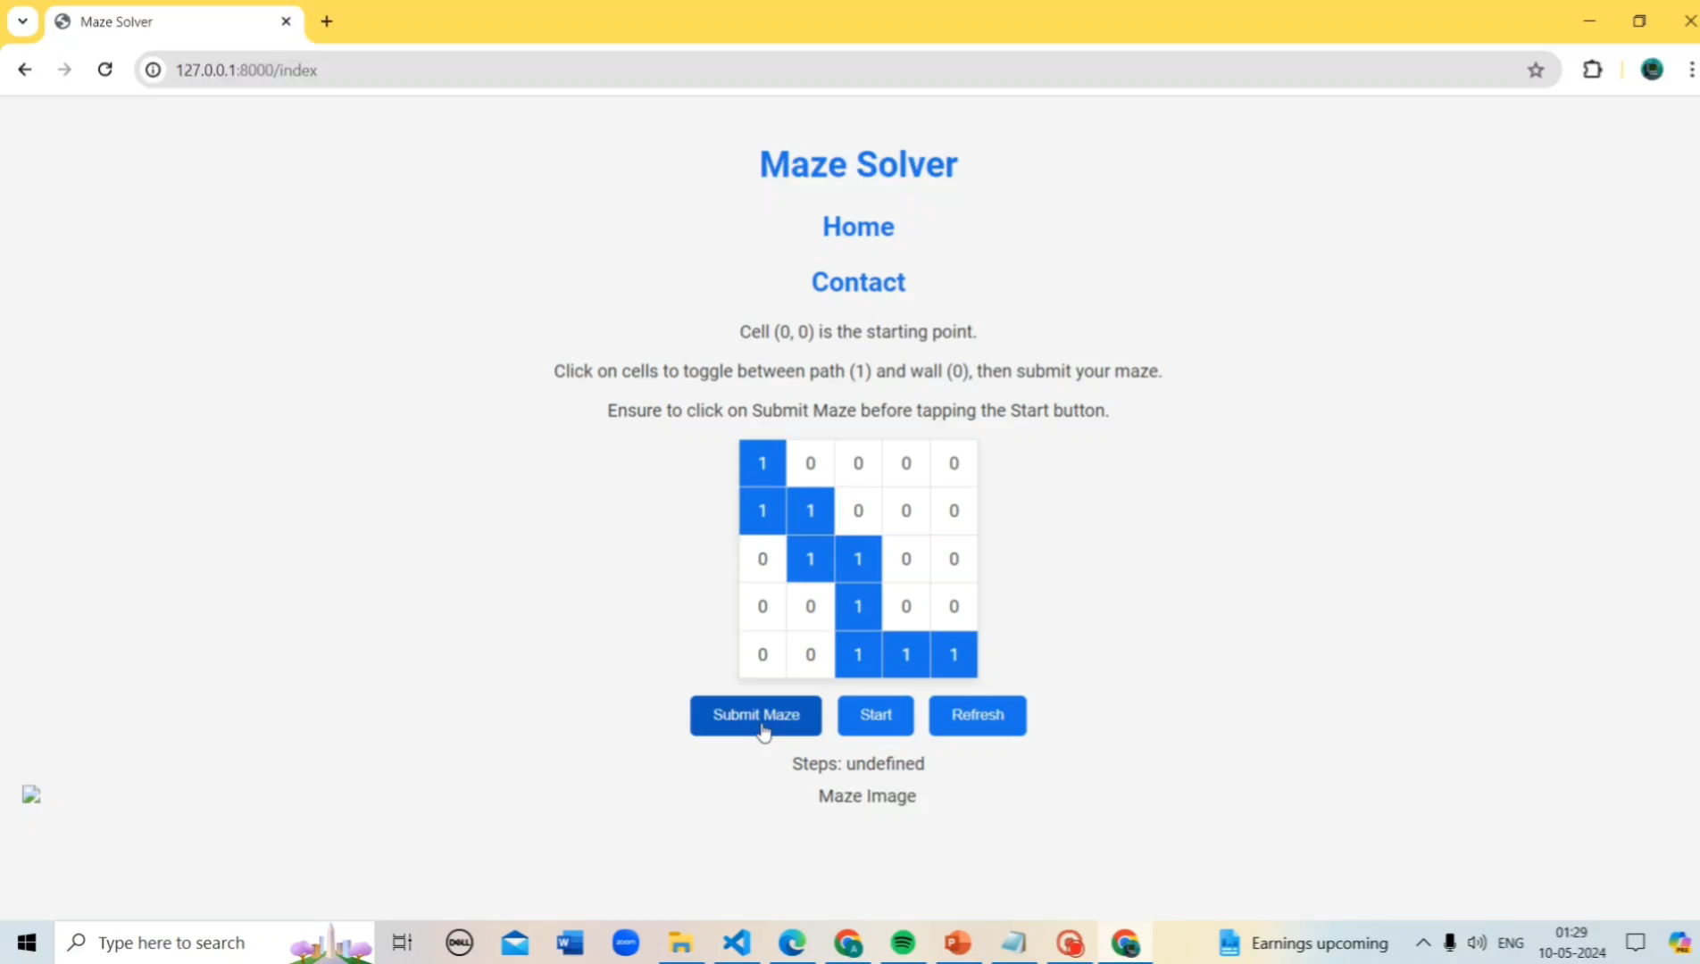

Slide 9
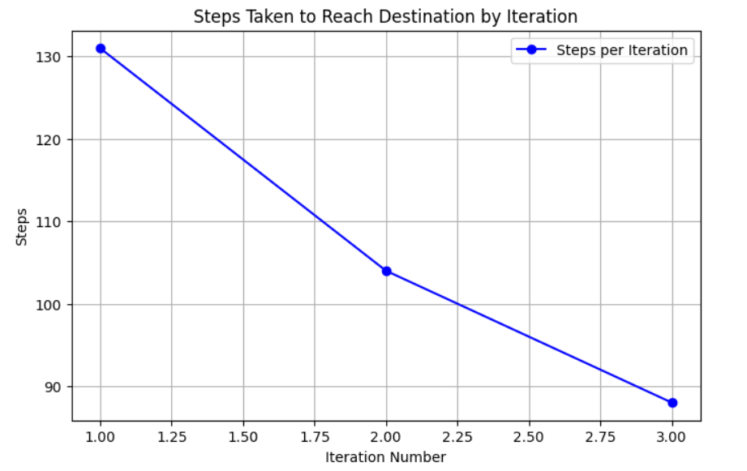
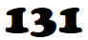


Results

Slide 10
Conclusion
Accuracy of our model based on Q-learning is 75% .
What makes reinforcement learning special is that it can learn from large amounts of data and find patterns that might be difficult for humans to spot. It doesn't need human intervention all the time because it can keep learning and getting better on its own.
But reinforcement learning has its limitations. Reinforcement learning can be time-consuming and require a lot of data and training to achieve good results.
In future we will try to overcome this problem.

Slide 11
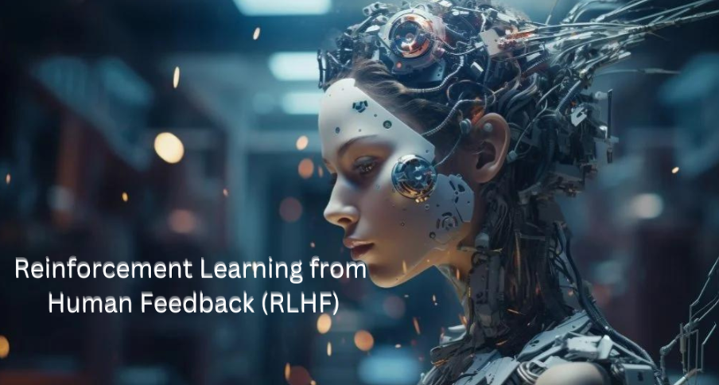
Alert!!!!!!!! “The primary technology behind ChatGPT is"

